Slide 1
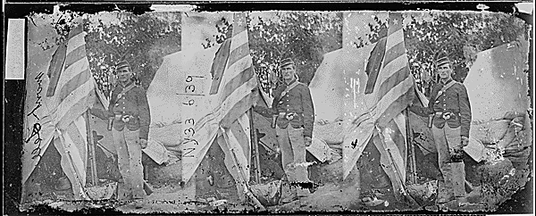
Colors of the 23rd New York Infantry
The 23rd New York Volunteer Infantry Regiment, also known as the “Southern Tier Regiment,” was a regiment under The Army of the Potomac and took part in campaigns such as the Peninsula and Gettysburg (Edmund).
We meet again :}
Notes:
Ok I’m done- Z

Slide 2
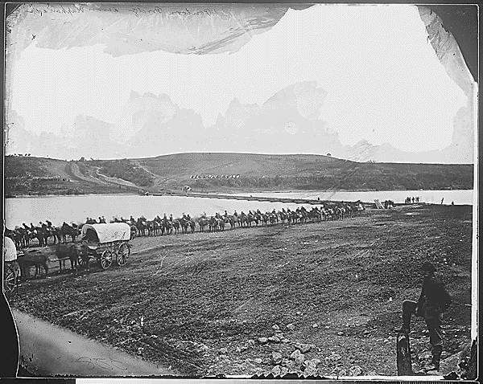
Pontoon Across the Rappahannock River, VA
A demonstration of the significance of the Rappahannock River, which was a central point during the war. Significant battles were fought along the river, including the famous Battle of Fredericksburg which would lead to the river being under Confederate control until General Ulysses S. Grant’s Wilderness Campaign (National Archives).

Slide 3
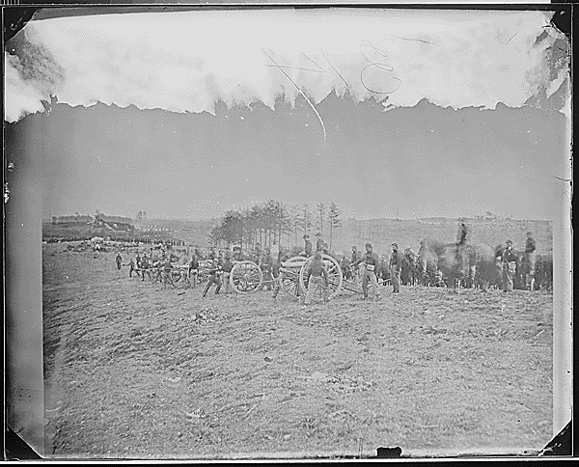
Battery in action at Fredericksburg, VA
This photo displays the use of new types of artillery during the Civil War such as the “12 Pounder Napoleon.” It also demonstrates the battle tactics of the time which consisted of lining up troops in open fields and fighting straight on, which led to high casualty counts (Britannica).

Slide 4
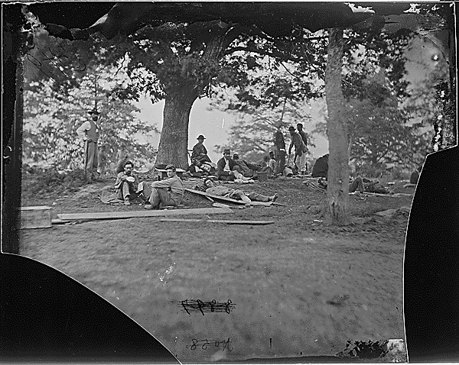
Wounded Soldiers Under Trees
This picture was taken after the Battle of Spotsylvania and it showed the poor conditions that many soldiers were forced to endure if they were injured. The picture was taken in Fredericksburg Texas, where Confederate soldiers retreated.

Slide 5
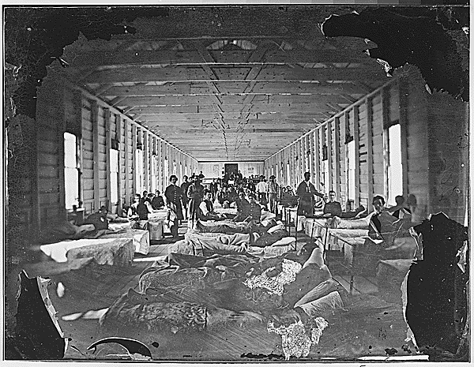
Wounded Soldiers In Hospital
This picture is taken of a group of wounded soldiers that have been taken to a hospital. As can be seen there were many injured that could no longer fight, and unfortunately due to poor medical understanding of the time many of these soldiers would die either from their wounds or rom disease.

Slide 6
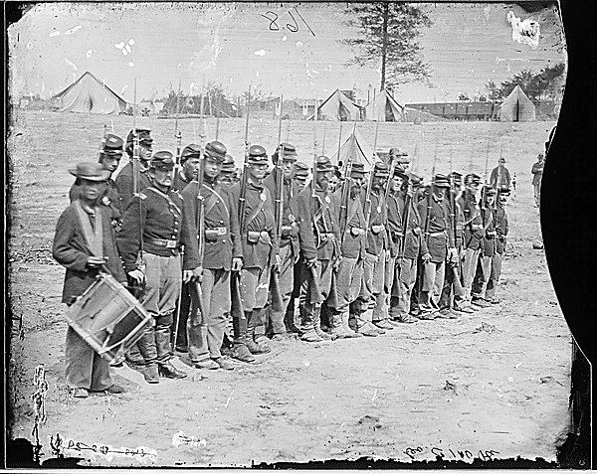
A Company the 6th Maine Infantry On Parade
This photo shows a company of Union soldiers after the Battle of Fredericksburg. The soldiers lined up are only half of the company that went into the battle, the other half were either killed or injured.

Slide 7
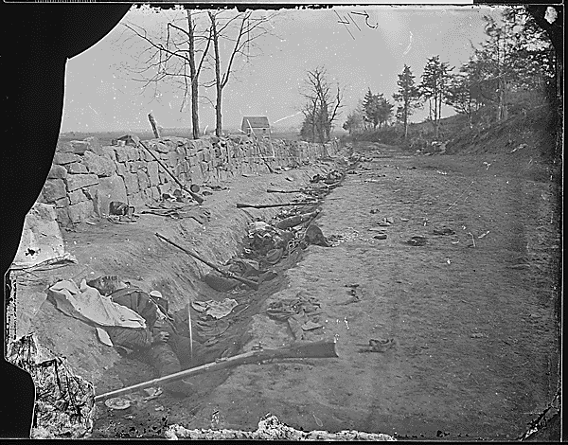
Confederate Dead at Fredericksburg Virginia
This picture taken after the battle is a sobering view of all the dead and wounded soldiers that were left behind. This picture fundamentally changed how many came to understand because before Mathew Brady most pictures of battle scenes removed the dead beforehand (National Archives).

Slide 8
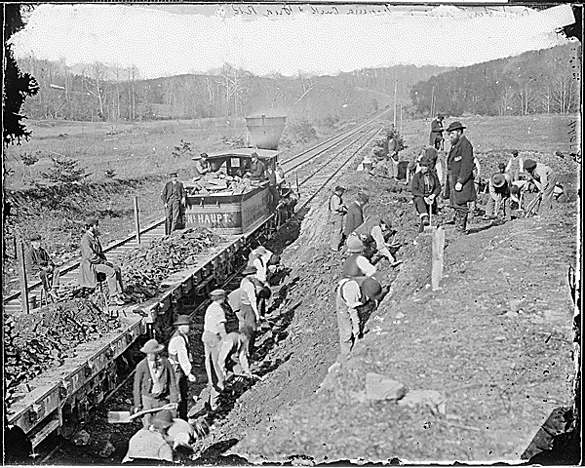
Aquia Creek and the Fredericksburg Railroad
A display of the importance of the railroad during the American Civil War, which was a vital development in transportation of goods and people. This is railroad is being built by a Union Construction Corps alongside the Pontiac River by Fredericksburg (National Archives).

Slide 9
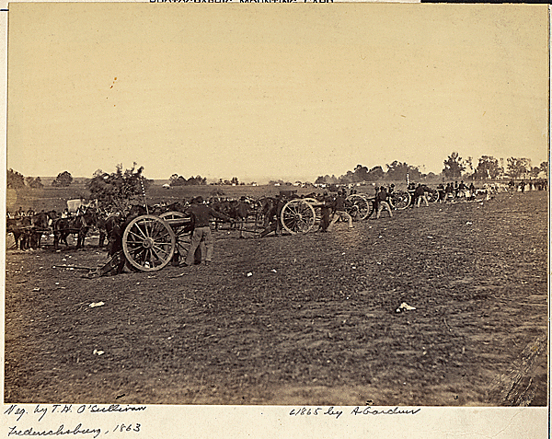
Battery D, 2nd U.S. Artillery, at Fredericksburg, VA
The image captures Union forces firing artillery shells at Confederate troops in 1863.

Slide 10
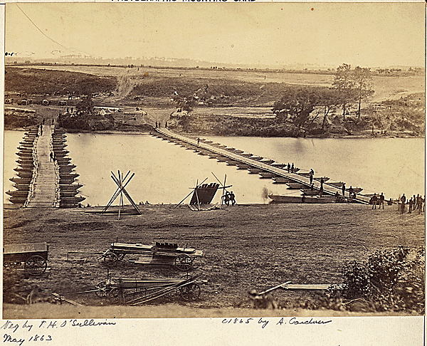
Pontoon bridge across the Rappahannock River at Fredericksburg, VA
The pontoon bridges depicted in the image were necessary during the war; the average weight of a cannon as well as the projectiles required vastly outweighed the possibility of crossing through the river. These floating bridges allowed for air held within to keep a solid bridge afloat.
T

Slide 11
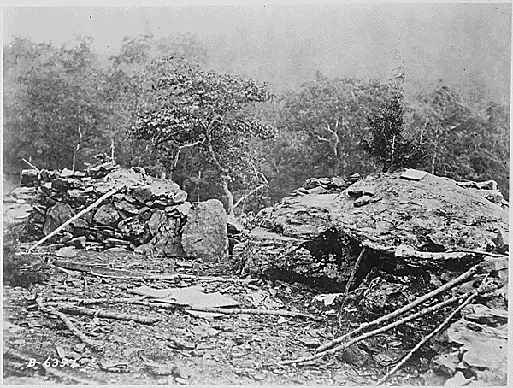
View of Union breastworks on Little Round Top
This image follows the Battle of Little Round Top, which resulted in a Union victory. It depicts a shoddy defense that likely was ruined due to cannon fire in the aftermath of the encounter.
T

Slide 12
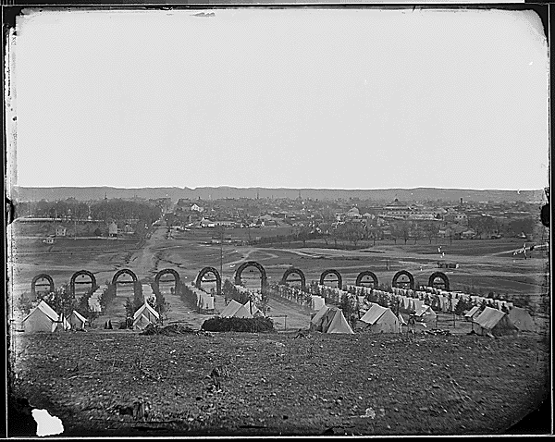
Camp of the 44th New York Infantry near Alexandria, VA
This photograph shows tents in the foreground with King Street in the background. This regiment was a volunteer regiment, brought about by some men in New York. They fought against the Confederate army in almost all of the Civil War’s major battles (Antietam, Bull Run, etc.).
T

Slide 13
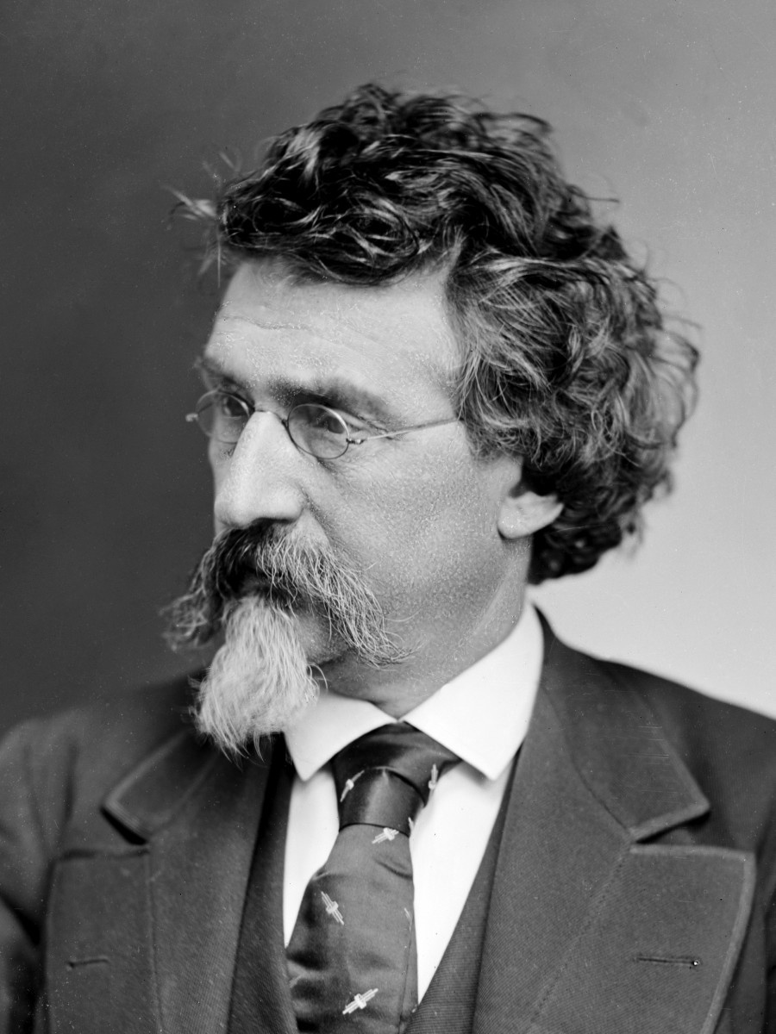
Matthew Brady was an American photographer who ultimately managed to bring the harsh realities of war to the American public for the first time in history. Largely known both for these haunting photos and also for portraits of presidents such as Abraham Lincoln and Andrew Jackson, Brady truly pushed forward the importance of the camera. His exhibition on The Battle of Antietam, entitled The Dead of Antietam, brought forth thousands of images in a never before seen fashion (Britannica School).
T

